Slide 1
Leadership

Slide 2
What is Leadership?
Leadership does not reside within an individual…
Leadership is emergent
The arising and effectiveness of leadership depend on something beyond your leader
Those who are led
LECTURES 12: Fundamentals ∙ Contingency Theories ∙ Relational Theories
Notes:
on one thing that is always changing. What is that thing?
You can manage system or manage a computer, but you don’t LEAD a system or computer… you lead PEOPLE. Leadership is an inherently human-focused phenomenon, and only exists when we consider both the leader and those who are led.

Slide 3
What is Leadership?
Leaders bring order to chaos
Leaders guide us through the complexities of life by facilitating organizational change; the most effective ones do so by changing personality
Our chief want is someone who will inspire us to be what we know we could be.
~Ralph Waldo Emerson
LECTURES 12: Fundamentals ∙ Contingency Theories ∙ Relational Theories

Slide 4
Leadership
Leadership is the process of influencing others to achieve group or organizational goals
Leaders encourage effective change in organizations; leadership is most effective when it taps into the beliefs and fundamental motivations of people, and uses that to transform them
LECTURES 12: Fundamentals ∙ Contingency Theories ∙ Relational Theories

Slide 5
Basics of Leadership
Early theories of leadership investigated leader attributes and their impact on leadership effectiveness
Although things like height have been found to predict leader emergence:
Personality is a better predictor of outcomes
Task-oriented traits (e.g., conscientiousness, IQ) predict performance and effectiveness
Interpersonal traits (i.e., extraversion, agreeableness) predict attitudes
LECTURES 12: Fundamentals ∙ Contingency Theories ∙ Relational Theories

Slide 6
Basics of Leadership
Many of the personal traits (stable psychological tendencies) associated with leadership are linked to traits we’ve already discussed in this class:
  Drive (conscientiousness, extraversion, need for achievement)
  Desire to lead (need for power)
  Honesty/integrity (agreeableness, values)
  Self-confidence (self-esteem, self-efficacy) and emotional stability
  Conceptual and analytical cognitive abilities (IQ), and knowledge of their business (human capital)
LECTURES 12: Fundamentals ∙ Contingency Theories ∙ Relational Theories

Slide 7
Basics of Leadership
Further research found that leaders generally perform two types of behaviors:
  Initiating structure (task-oriented): Defining and organizing work relationships and roles, establishing patterns of communication and task accomplishment
  Consideration (person-oriented): Nurturing friendly and warm working relationships, encouraging mutual trust and respect
  Mich-Ohio State-Minnesota studies 1950s
LECTURES 12: Fundamentals ∙ Contingency Theories ∙ Relational Theories

Slide 8
Basics of Leadership
LECTURES 12: Fundamentals ∙ Contingency Theories ∙ Relational Theories

Slide 9

Basics of Leadership
The Leadership Grid associated the two types of leader behavior with one another, thus illustrating the existence of different leadership styles
High
Concern for
People
Low
Low
High
Concern for Production
LECTURES 12: Fundamentals ∙ Contingency Theories ∙ Relational Theories

Slide 10
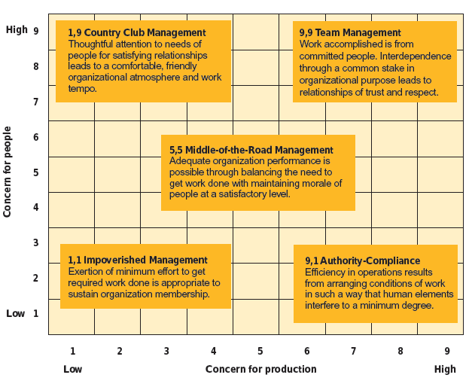
Basics of Leadership
LECTURES 12: Fundamentals ∙ Contingency Theories ∙ Relational Theories

Slide 11
** test Contingency Theories
Contingency theories assert that the leadership style must be appropriate for the particular situation in order to enhance worker performance
Fiedler’s Contingency Theory asserts that leaders are either task-oriented or relationship-oriented (assessed via LPC), and function more or less effectively based on the favorableness of the context in which they function
LECTURES 12: Fundamentals ∙ Contingency Theories ∙ Relational Theories

Slide 12
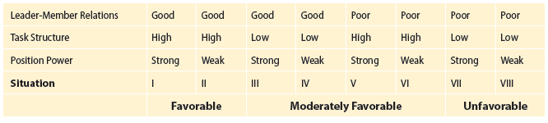
Contingency Theories
Situation favorability:
Task-oriented leaders are effective in highly favorably or unfavorable situations
Relationship-oriented leaders are effective in moderately favorable situations
LECTURES 12: Fundamentals ∙ Contingency Theories ∙ Relational Theories

Slide 13
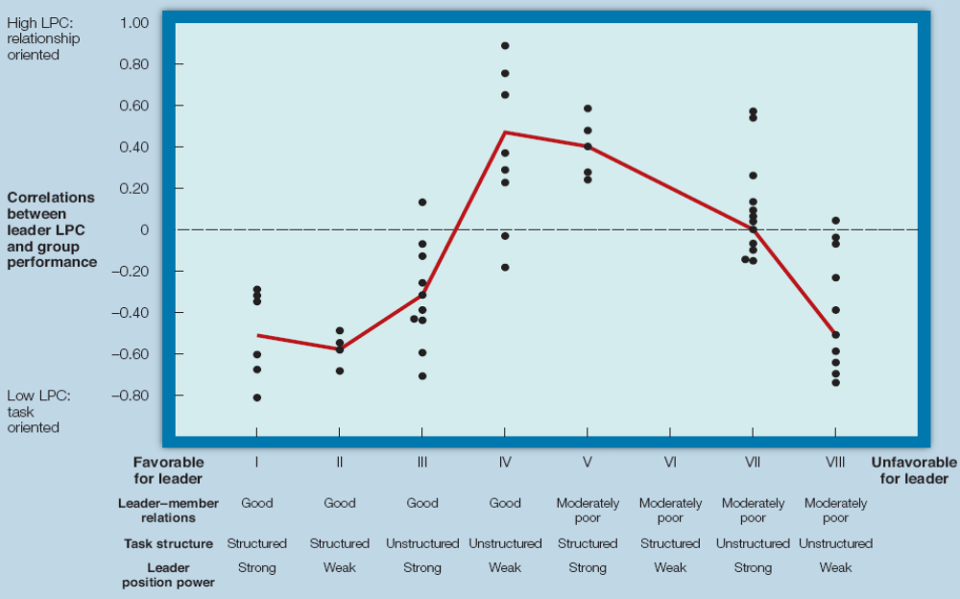
Contingency Theories
LECTURES 12: Fundamentals ∙ Contingency Theories ∙ Relational Theories

Slide 14
Contingency Theories
Situational Leadership Model suggests that leader behavior (task, relationship) should be adjusted to follower maturity (ability, motivation) for performing any given task
First, identify the employees maturity/readiness, second, decide on the appropriate amount of relationship or task behaviors
LECTURES 12: Fundamentals ∙ Contingency Theories ∙ Relational Theories

Slide 15
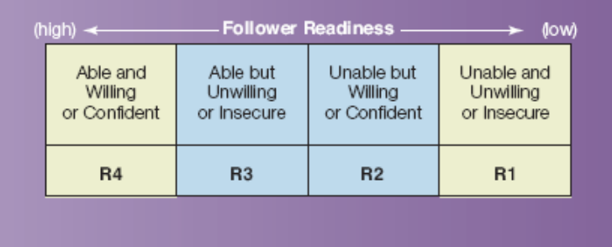
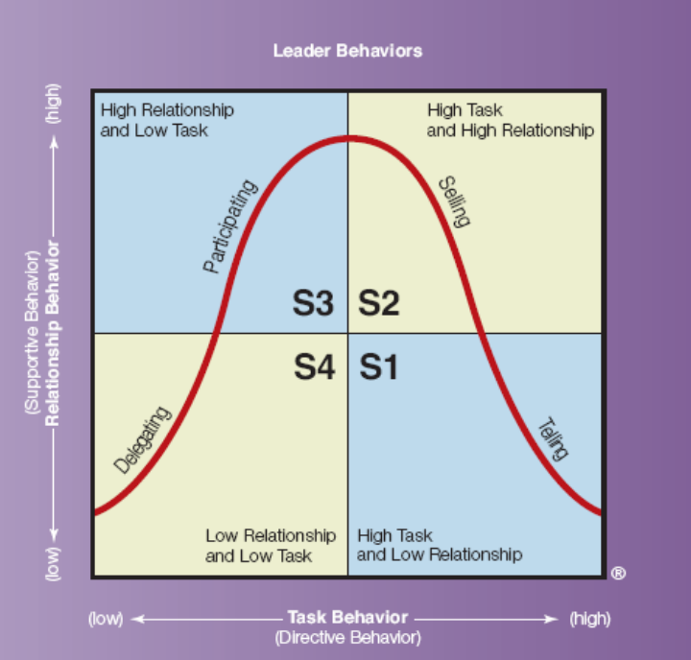
Contingency Theories
LECTURES 12: Fundamentals ∙ Contingency Theories ∙ Relational Theories

Slide 16
Relational Theories
Leader-member exchange (LMX) theory finds that leaders form different unique relationships with different followers, they do not treat them all the same
Leaders informally (and perhaps non-consciously) assign subordinates to the in-group or the out-group because they have limited resources (e.g., time, attention) to distribute among employees
LECTURES 12: Fundamentals ∙ Contingency Theories ∙ Relational Theories

Slide 17
Relational Theories
Subordinates negotiate and develop their work roles via interactions with their leaders
In-group members experience:
Trust, autonomy/discretion in developing role, attention, resources, challenging tasks, rewards, clearer understanding of leader expectations
Out-group members experience:
Fewer rewards, less attention, guidance based on policy and procedure, less responsibility
LECTURES 12: Fundamentals ∙ Contingency Theories ∙ Relational Theories

Slide 18
Relational Theories
The quality of LMX depends on:
Perceived contribution to the exchange
Loyalty, expression of support
Affect, mutual attraction
LMX is strongly related to:
Subordinate job performance, satisfaction with supervisor, job satisfaction, commitment, positive role perceptions, competence
LECTURES 12: Fundamentals ∙ Contingency Theories ∙ Relational Theories

Slide 19
Transactional
Transactional leaders (TXL) engage in mutual exchanges with followers, enforced by rewards and punishments
Lower-order exchanges involve:
Goals (e.g., pay) and aspirations (e.g., success)
Higher-order exchanges involve:
Interpersonal relations and mutuality (e.g, trust, respect , emotional support)
LECTURES 12: Fundamentals ∙ Contingency Theories ∙ Relational Theories

Slide 20
Transformational
LECTURES 12: Fundamentals ∙ Contingency Theories ∙ Relational Theories

Slide 21
Transformational leadership bound by belief- about transforming employees values
Transformational leaders behave according to deeply held values that can then influence the values and goals of followers, and inspire followers to achieve superior levels of performance
Transformational leaders have strong personal characteristics; they are able to transcend their personal goals and loyalties in order to advance core beliefs and values
LECTURES 12: Fundamentals ∙ Contingency Theories ∙ Relational Theories

Slide 22
Transformational
Transformational leaders engage in the following four behaviors/styles:
Idealized influence: Strong personal qualities, values, or beliefs that elicit liking/attraction and regard; exceptional role model or image
Inspirational motivation (charisma): Infusing work with personal meaning, generating a vision for the future, setting challenging performance standards
LECTURES 12: Fundamentals ∙ Contingency Theories ∙ Relational Theories

Slide 23
Transformational cult
Individualized consideration: Concern for each follower’s unique goals and needs, and providing personalized mentoring
Intellectual stimulation: Challenging followers to take new perspectives, move beyond their habitual or ineffective behaviors, innovate, challenge organizational norms
LECTURES 12: Fundamentals ∙ Contingency Theories ∙ Relational Theories

Slide 24
Transformational
Transformational leadership predicts:
Firm performance, extra effort exerted towards job performance, positive attitudes (e.g., satisfaction, commitment)
Transformational leadership is as effective as contingent reward leadership (one part of TXL), yet is less dependent on access to resources and it more stable over time
LECTURES 12: Fundamentals ∙ Contingency Theories ∙ Relational Theories

Slide 25
Charismatic
Charismatic leadership is -Transformative leadership for the masses
LECTURES 12: Fundamentals ∙ Contingency Theories ∙ Relational Theories

Slide 26
Charismatic
Charisma means “favor given” or “gift of grace” in Greek, and is associated with charm, kindness, being blessed
Charisma resides in the relationship between leader and followers, wherein followers ascribe highly positive inspirational qualities to a leader
Charisma – attributional -is not constant not enduring – comes and goes
LECTURES 12: Fundamentals ∙ Contingency Theories ∙ Relational Theories

Slide 27
Charismatic
Charismatic leadership is a part of transformational leadership, but relies more on using personal qualities/values to inspire a vision of the future
Followers will adhere to a leader’s ideals to the extent that:
  The leader’s vision satisfies the needs of the followers
  Identification with the leader is self-enhancing (self-efficacy is boosted)
LECTURES 12: Fundamentals ∙ Contingency Theories ∙ Relational Theories

Slide 28
Charismatic
four things to be attributed with charisma
Charisma is an attributional process; people will ascribe charisma to a leader based on:
  Degree of discrepancy between status quo and leader’s vision/goals
  Innovative means are used to create change radical change
  Realism of assessments of resources available for change and barriers to change
  Impression management effectiveness
LECTURES 12: Fundamentals ∙ Contingency Theories ∙ Relational Theories

Slide 29
Charismatic
Riskier behaviors, goals, and decisions for the sake of fulfilling one’s vision, will enhance attributions of charisma
Charisma (and charismatic leadership) is transitory and mainly arises when there is uncertainty and disenchantment among followers
LECTURES 12: Fundamentals ∙ Contingency Theories ∙ Relational Theories

